Slide 1
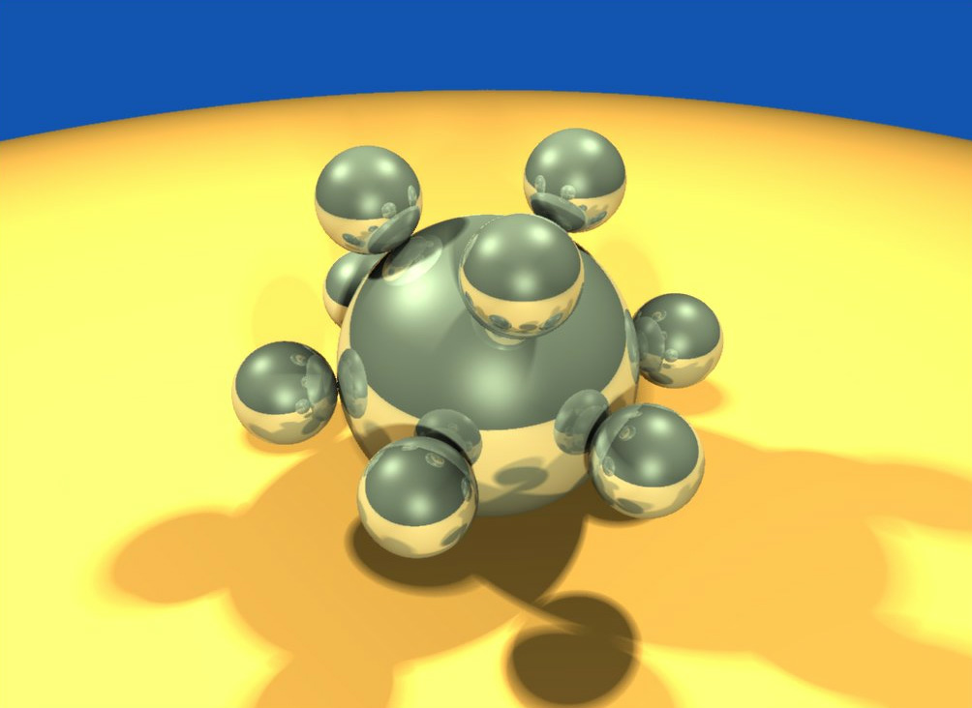
Computer Graphics using OpenGL,
3rd Edition
F. S. Hill, Jr. and S. Kelley
Chapter 3
Additional Drawing Tools
S. M. Lea
University of North Carolina at Greensboro
© 2007, Prentice Hall

Slide 2
More on Coordinate Systems
We have been using the coordinate system of the screen window (in pixels).
The range is from 0 (left) to some value screenWidth – 1 in x, and from 0 (usually top) to some value screenHeight –1 in y.
  We can use only positive values of x and y.
  The values must have a large range (several hundred pixels) to get a reasonable size drawing.

Slide 3
Coordinate Systems (2)
It may be much more natural to think in terms of x varying from, say, -1 to 1, and y varying from –100.0 to 20.0.
We want to separate the coordinates we use in a program to describe the geometrical object from the coordinates we use to size and position the pictures of the objects on the display.
Description is usually referred to as a modeling task, and displaying pictures as a viewing task.

Slide 4
Coordinate Systems (3)
The space in which objects are described is called world coordinates (the numbers used for x and y are those in the world, where the objects are defined).
World coordinates use the Cartesian xy-coordinate system used in mathematics, based on whatever units are convenient.

Slide 5
Coordinate Systems (4)
We define a rectangular world window in these world coordinates.
The world window specifies which part of the world should be drawn: whichever part lies inside the window should be drawn, and whichever part lies outside should be clipped away and not drawn.
OpenGL does the clipping automatically.

Slide 6
Coordinate Systems (5)
In addition, we define a rectangular viewport in the screen window on the display.
A mapping (consisting of scalings [change size] and translations [move object]) between the world window and the viewport is established by OpenGL.
The objects inside the world window appear automatically at proper sizes and locations inside the viewport (in screen coordinates, which are pixel coordinates on the display).

Slide 7
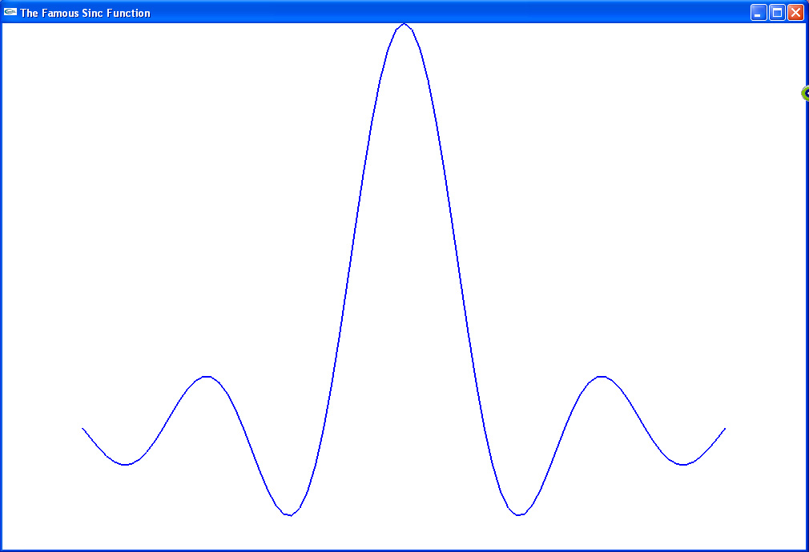
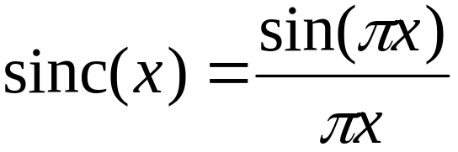
Coordinate Systems Example
We want to graph
Sinc(0) = 1 by definition. Interesting parts of the function are in -4.0 ≤ x ≤ 4.0.

Slide 8
Coordinate Systems Example (2)
The program which graphs this function is given in Fig. 3.3.
The function setWindow sets the world window size:
void setWindow(GLdouble left, GLdouble right, GLdouble bottom, GLdouble top)
{ glMatrixMode(GL_PROJECTION);
glLoadIdentity();
gluOrtho2D(left, right, bottom, top);}

Slide 9
Coordinate Systems Example (3)
The function setViewport sets the screen viewport size:
void setViewport(GLint left, GLint right, GLint bottom, GLint top)
{ glViewport(left, bottom, right - left, top - bottom);}
Calls: setWindow(-5.0, 5.0, -0.3, 1.0);
setViewport(0, 640, 0, 480);

Slide 10
Windows and Viewports
We use natural coordinates for what we are drawing (the world window).
OpenGL converts our coordinates to screen coordinates when we set up a screen window and a viewport. The viewport may be smaller than the screen window. The default viewport is the entire screen window.
The conversion requires scaling and shifting: mapping the world window to the screen window and the viewport.

Slide 11
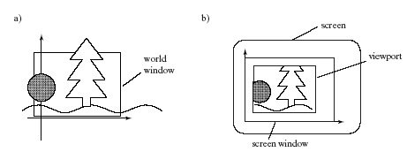
Windows and Viewport

Slide 12
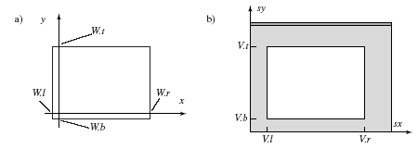
Mapping Windows
Windows are described by their left, top, right, and bottom values, w.l, w.t, w.r, w.b.
Viewports are described by the same values: v.l, v.t, v.r, v.b, but in screen window coordinates.

Slide 13
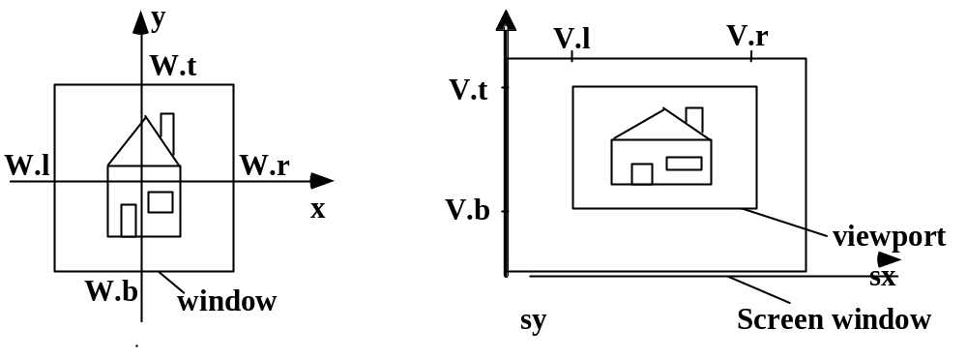
Mapping (2)
We can map any aligned rectangle to any other aligned rectangle.
  If the aspect ratios of the 2 rectangles are not the same, distortion will result.

Slide 14

Window-to-Viewport Mapping
We want our mapping to be proportional: for example, if x is ¼ of the way between the left and right world window boundaries, then the screen x (s_{x}) should be ¼ of the way between the left and right viewport boundaries.

Slide 15
Window-to-Viewport Mapping (2)
This requirement forces our mapping to be linear.
  sx= Ax + C, sy = B y + D
  We require (sx – V.l)/(V.r – V.l) = (x – W.l)/(W.r – W.l), giving
    sx = x*[(V.r-V.l)/(W.r-W.l)] + {V.l – W.l*[(V.r-V.l)/(W.r-W.l)]}, or A = (V.r-V.l)/(W.r-W.l), C = V.l – A*w.l

Slide 16
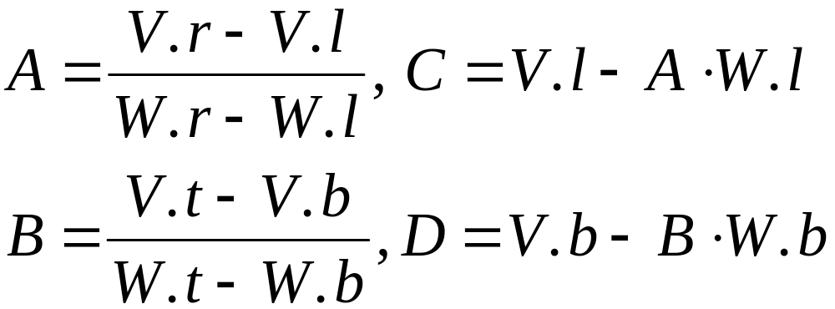
Window-to-Viewport Mapping (3)
  We likewise require (sy – V.b)/(V.t – V.b) = (y – W.b)/(W.t – W.b), giving
    B = (V.t-V.b)/(W.t-W.b), D = V.b – B*W.b
Summary: sx = A x + C, sy = B y + D, with

Slide 17
GL Functions To Create the Map
World window: void gluOrtho2D(GLdouble left, GLdouble right, GLdouble bottom, GLdouble top);
Viewport: void glViewport(GLint x, GLint y, GLint width, GLint height);
  This sets the lower left corner of the viewport, along with its width and height.

Slide 18
GL Functions To Create the Map (2)
Because OpenGL uses matrices to set up all its transformations, the call to gluOrtho2D() must be preceded by two setup functions: glMatrixMode(GL_PROJECTION);
and glLoadIdentity();
setWindow() and setViewport() are useful code “wrappers”.
  They simplify the process of creating the window and viewport.

Slide 19
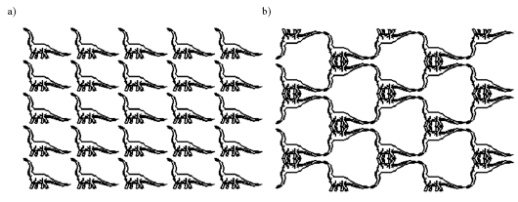
Application:Tiling with Viewports

Slide 20
Applications (continued)
Tiling A was set up by the following code:
  setWindow(0, 640.0, 0, 440.0); // set a fixed window
  for (int i = 0; i < 5; i++) // for each column
  for (int j = 0; j < 5; j++){ // for each row
  {glViewport (i*64, j*44,64, 44); // set the next viewport
  drawPolylineFile("dino.dat"); // draw it again
  }
Tiling B requires more effort: you can only turn a window upside down, not a viewport.

Slide 21
Applications (continued)
Code for Tiling B
for (int i = 0; i < 5; i++) // for each column
  for (int j = 0; j < 5; j++){ // for each row
  if ((i + j) % 2 == 0){
  setWindow(0.0, 640.0, 0.0, 440.0);
  } else {
  setWindow(0.0, 640.0, 440.0, 0.0); // upside-down
  }
  glViewport (i*64, j*44,64, 44); // no distortion
  drawPolylineFile("dino.dat"); }

Slide 22
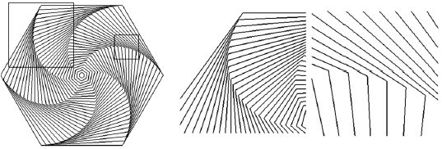
Application: Clip, Zoom and Pan
Clipping refers to viewing only the parts of an image that are in the window.

Slide 23
Application (continued)
The figure is a collection of concentric hexagons of various sizes, each rotated slightly with respect to the previous one. It is drawn by a function called hexSwirl ();
The figure showed 2 choices of world windows.
We can also use world windows for zooming and roaming (panning).

Slide 24
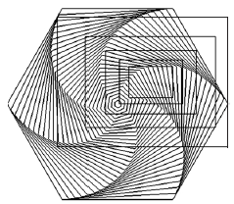
Zooming and Panning
To zoom, we pick a concentric set of windows of decreasing size and display them from outside in.

Slide 25
Zooming and Roaming (2)
The animation of the zoom will probably not be very smooth. We want to look at one drawing while the next one is drawn, and then switch to the new drawing.
  We use glutInitDisplayMode (GLUT_DOUBLE | GLUT_RGB); //gives us 2 buffers, one to look at and one to draw in
  We add glutSwapBuffers(); after the call to hexSwirl (); // change to the new drawing

Slide 26
Roaming (Panning)
To roam, or pan, we move a viewport through various portions of the world. This is easily accomplished by translating the window to a new position.
What sequence of windows would you want in order to roam through the image?

Slide 27
Resizing the Screen Window
Users are free to alter the size and aspect ratio of the screen window.
You may want GL to handle this event so that your drawing does not get distorted.
Register the reshape function:
glutReshapeFunc (myReshape);
Void myReshape (GLsizei W, GLsizei H); collects the new width and height for the window.

Slide 28
Preserving Aspect Ratio
We want the largest viewport which preserves the aspect ratio R of the world window.
Suppose the screen window has width W and height H:
  If R > W/H, the viewport should be width W and height W/R
  If R < W/H, the viewport should be width H*R and height H
  What happens if R = W/H?

Slide 29
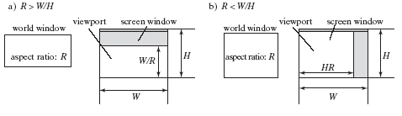
Automatic Aspect Ratio Preservation for Viewports

Slide 30
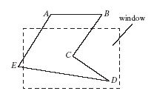
Clipping Lines
We want to draw only the parts of lines that are inside the world window.
To do this, we need to replace line portions outside the window by lines along the window boundaries. The process is called clipping the lines.

Slide 31
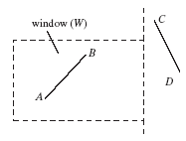
Clipping (2)
The method we will use is called Cohen-Sutherland clipping.
There are 2 trivial cases: a line AB totally inside the window, which we draw all of, and a line CD totally outside the window, which we do not draw at all.

Slide 32
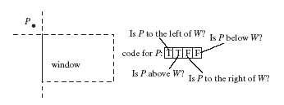
Clipping (3)
For all lines, we give each endpoint of the line a code specifying where it lies relative to the window W:

Slide 33
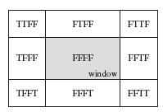
Clipping (4)
The diagram below shows Boolean codes for the 9 possible regions the endpoint lies in (left, above, below, right).

Slide 34
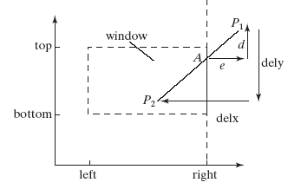
Clipping (5)
A line consists of 2 endpoints (vertices), P₁ and P₂. If we do not have a trivial case, we must alter the vertices to the points where the line intersects the window boundaries (replace P₁ by A).

Slide 35
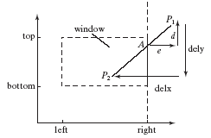
Clipping (6)
In the diagram, d/dely = e/delx (similar triangles).
Obviously, A.x = W.r.
Also, delx = p₁.x – p₂.x, dely = p₁.y – p₂.y and e = p₁.x – W.r.
So A.y = p₁.y – d.

Slide 36
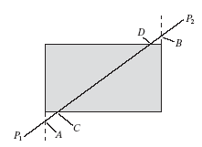
A Line Needing 4 Clips
The equation of the line is y = x * (p₁.y – p₂.y)/(p₁.x – p₂.x) + p₂.y = mx + p₂.y.
The intersection B with the top window boundary is at x where y = W.t, or x = (W.t – p₂.y)/m.
The intersection A with the right boundary is y where x = W.r, or y = m*W.r + p₂.y.

Slide 37
Clipping Pseudocode
Complete pseudocode for the Cohen-Sutherland Line Clipper is shown in Fig. 3.21.

Slide 38
Drawing Regular Polygons, Circles, and Arcs
A polygon is regular if it is simple, if all its sides have equal length, and if adjacent sides meet at equal interior angles.
A polygon is simple if no two of its edges cross each other. More precisely, only adjacent edges can touch and only at their shared endpoint.
We give the name n-gon to a regular polygon having n sides; familiar examples are the 4-gon (a square), an 8-gon (a regular octagon) and so on.

Slide 39
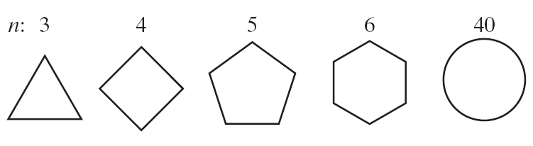
Regular Polygons

Slide 40
Drawing Circles and Arcs
Two methods:
  The center is given, along with a point on the circle.
    Here drawCircle( IntPoint center, int radius) can be used as soon as the radius is known. If c is the center and p is the given point on the circle, the radius is simply the distance from c to p, found using the usual Pythagorean Theorem.

Slide 41
Drawing Circles and Arcs
  Three points are given through which the circle must pass.
    It is known that a unique circle passes through any three points that don't lie in a straight line.
    Finding the center and radius of this circle is discussed in Chapter 4.

Slide 42
Successive Refinement of Curves
Very complex curves can be fashioned recursively by repeatedly “refining” a simple curve.
Example: the Koch curve, which produces an infinitely long line within a region of finite area.

Slide 43
Koch Curves
Successive generations of the Koch curve are denoted K₀, K₁, K₂,…
The 0-th generation shape K₀ is just a horizontal line of length 1.
The curve K₁ is created by dividing the line K₀ into three equal parts, and replacing the middle section with a triangular bump having sides of length 1/ 3. The total line length is evidently 4 / 3.

Slide 44
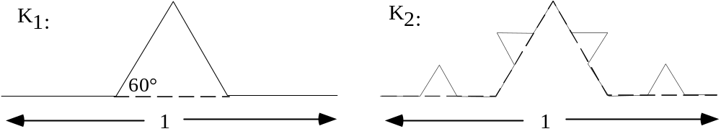
Koch Curves (2)
The second-order curve K₂ is formed by building a bump on each of the four line segments of K₁.

Slide 45
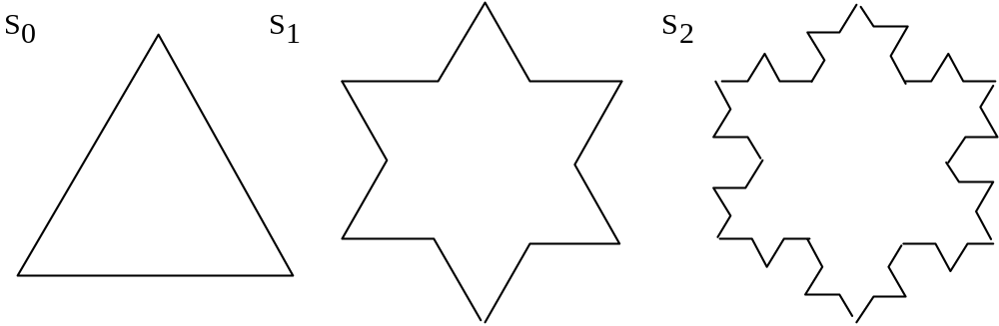
Koch Snowflake (3 joined curves)
Perimeter: the i-th generation shape S_{i} is three times the length of a simple Koch curve, 3(4/3)^{i}, which grows forever as i increases.
Area inside the Koch snowflake: grows quite slowly, and in the limit, the area of S∞ is only 8/5 the area of S₀.

Slide 46
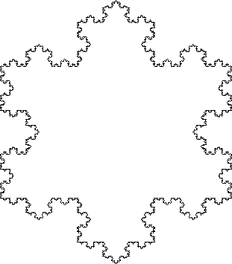
Fifth-generation Koch Snowflake

Slide 47
Parametric Curves
Three forms of equation for a given curve:
  Explicit: e.g., y = m*x + b
  Implicit: F(x, y) = 0; e.g., y – m*x –b = 0
  Parametric: x = x(t), y = y(t), t a parameter; frequently, 0 ≤ t ≤ 1. E.g., P = P₁*(1-t) + P₂*t.
    P₁ and P₂ are 2D points with x and y values. The parametric form is x = x₁*(1-t) + x₂*t and y = y₁*(1-t) + y₂*t.

Slide 48
Specific Parametric Forms
line: x = x₁*(1-t) + x₂*t and y = y₁*(1-t) + y₂*t
circle: x = r*cos(2π t), y = r*sin(2π t)
ellipse: x = W*r*cos(2π t), y = H*r*sin(2π t)
  W and H are half-width and half-height.

Slide 49
Finding Implicit Form from Parametric Form
Combine the x(t) and y(t) equations to eliminate t.
Example: ellipse: x = W*r*cos(2π t), y = H*r*sin(2π t)
  X² = W²r²cos²(2π t), y² = H²r²sin²(2π t).
  Dividing by the W or H factors and adding gives (x/W)² + (y/H)² = 1, the implicit form.

Slide 50
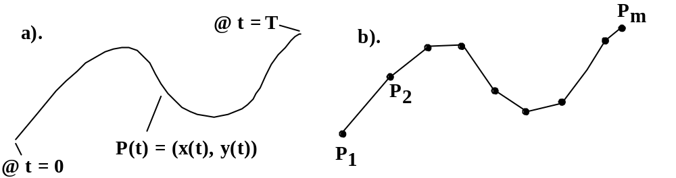
Drawing Parametric Curves
For a curve C with the parametric form P(t) = (x(t), y(t)) as t varies from 0 to T, we use samples of P(t) at closely spaced instants.

Slide 51
Drawing Parametric Curves (2)
  The position P_{i} = P(t_{i}) = (x(t_{i}), y(t_{i})) is calculated for a sequence {t_{i}} of times.
  The curve P(t) is approximated by the polyline based on this sequence of points P_{i}.

Slide 52
Drawing Parametric Curves (3)
Code:
// draw the curve (x(t), y(t)) using
// the array t[0],..,t[n-1] of sample times
glBegin(GL_LINES);
for(int i = 0; i < n; i++)
glVertex2f((x(t[i]), y(t[i]));
glEnd();

Slide 53
Parametric Curves: Advantages
For drawing purposes, parametric forms circumvent all of the difficulties of implicit and explicit forms.
Curves can be multi-valued, and they can self-intersect any number of times.
Verticality presents no special problem: x(t) simply becomes constant over some interval in t.

Slide 54
Polar Coordinates Parametric Form
x = f(θ)*cos(θ), y = f(θ)*sinθ
  cardioid: f(θ) = K*(1 + cos(θ)), 0 ≤ θ ≤ 2π
  rose: f(θ) = K cos(n*θ), 0 ≤ θ ≤ 2nπ, where n is number of petals (n odd) or twice the number of petals (n even)
  spirals: Archimedean, f(θ) = Kθ; logarithmic, f(θ) = Ke^{aθ}
K is a scale factor for the curves.

Slide 55
Polar coordinates Parametric Form (2)
  conic sections (ellipse, hyperbola, circle, parabola): f(θ) = (1 ± e cos θ)⁻¹
    e is eccentricity:
      1 : parabola;
      0 : circle;
      between 0 and 1, ellipse;
      greater than 1, hyperbola

Slide 56
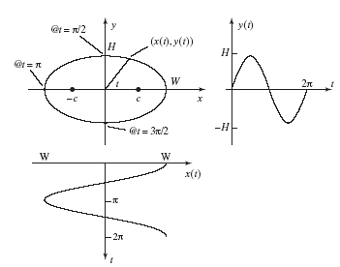
Example for Ellipse

Slide 57
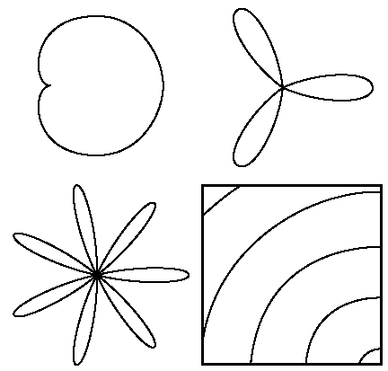
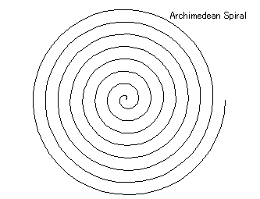
Shapes
Cardioid, 2 rose curves, Archimedean spiral

